Slide 1
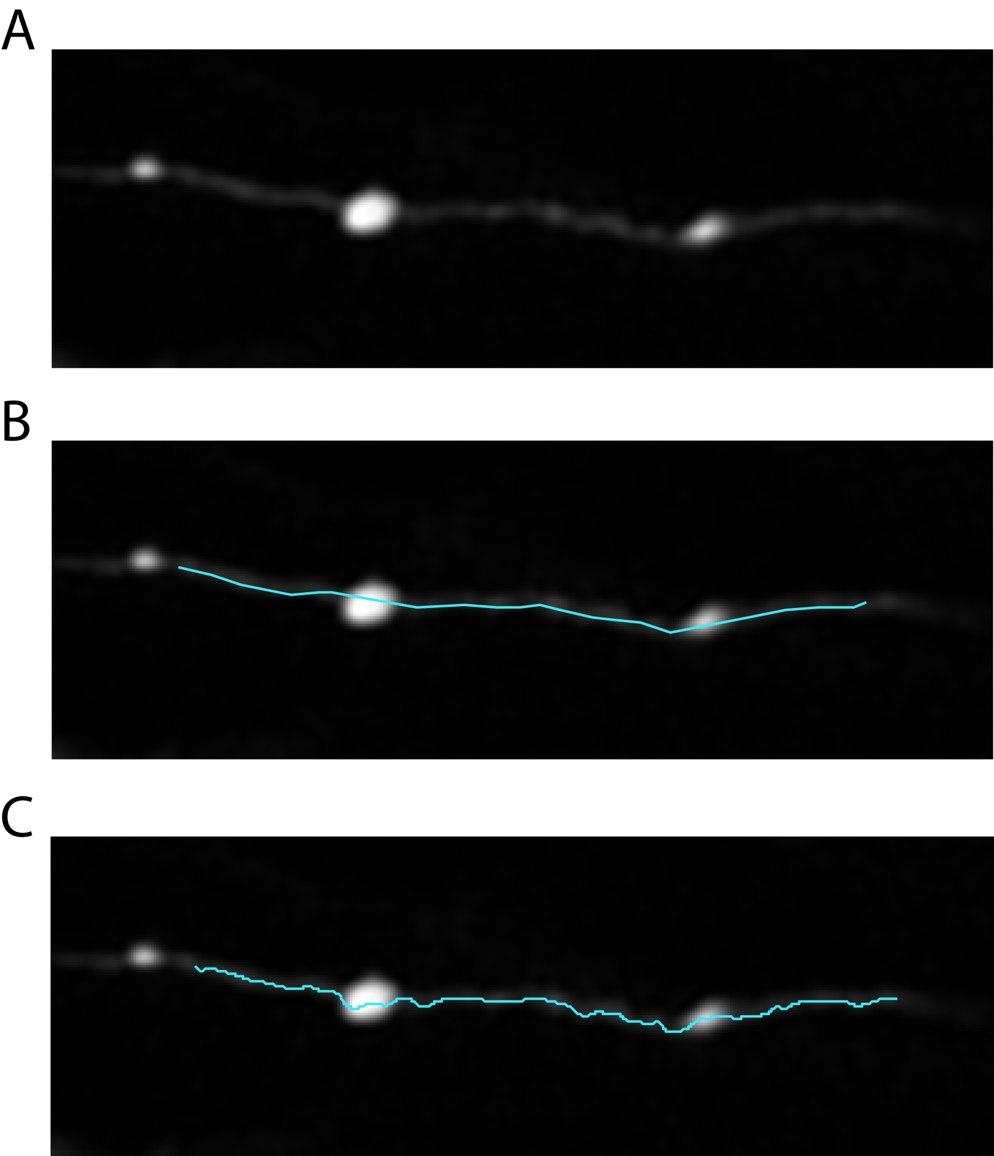
Figure 1. Auto-centered backbone trace. A. In-plane axon segment. B. User roughly traces axon path, placing points along path in best plane (chosen by local axon intensity and clarity). C. Algorithm creates line perpendicular to hand clicked segments, thresholds intensity profile by twice the median background intensity for the whole stack (in user defined fields), finds largest thresholded segment, then picks maximum intensity pixel in that blob. Performs in .4 um intervals. Fails in crowded fields (failures manually excluded by user) and for low intensity regions (automatically excluded at threshold manually set by user for each axon).

Slide 2
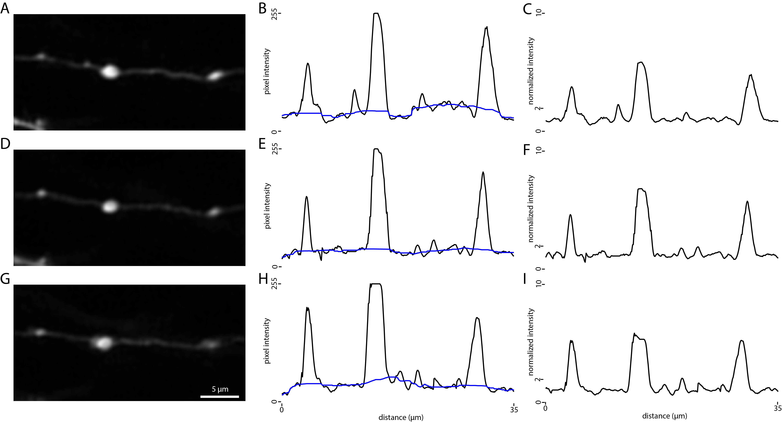

Slide 3
Figure 2: Normalized Intensity Profile. A,D,G. Subsection of analyzed axon (averaged across best planes for included segment) for pre-training, post-training, and post-rest imaging timepoints. B,E,H. Pixel intensity along axon trace snapped to backbone (black) and median filtered backbone baseline intensity (blue, window ~10 um). C,F,I. Axon profile intensity normalized to median backbone baseline.

Slide 4
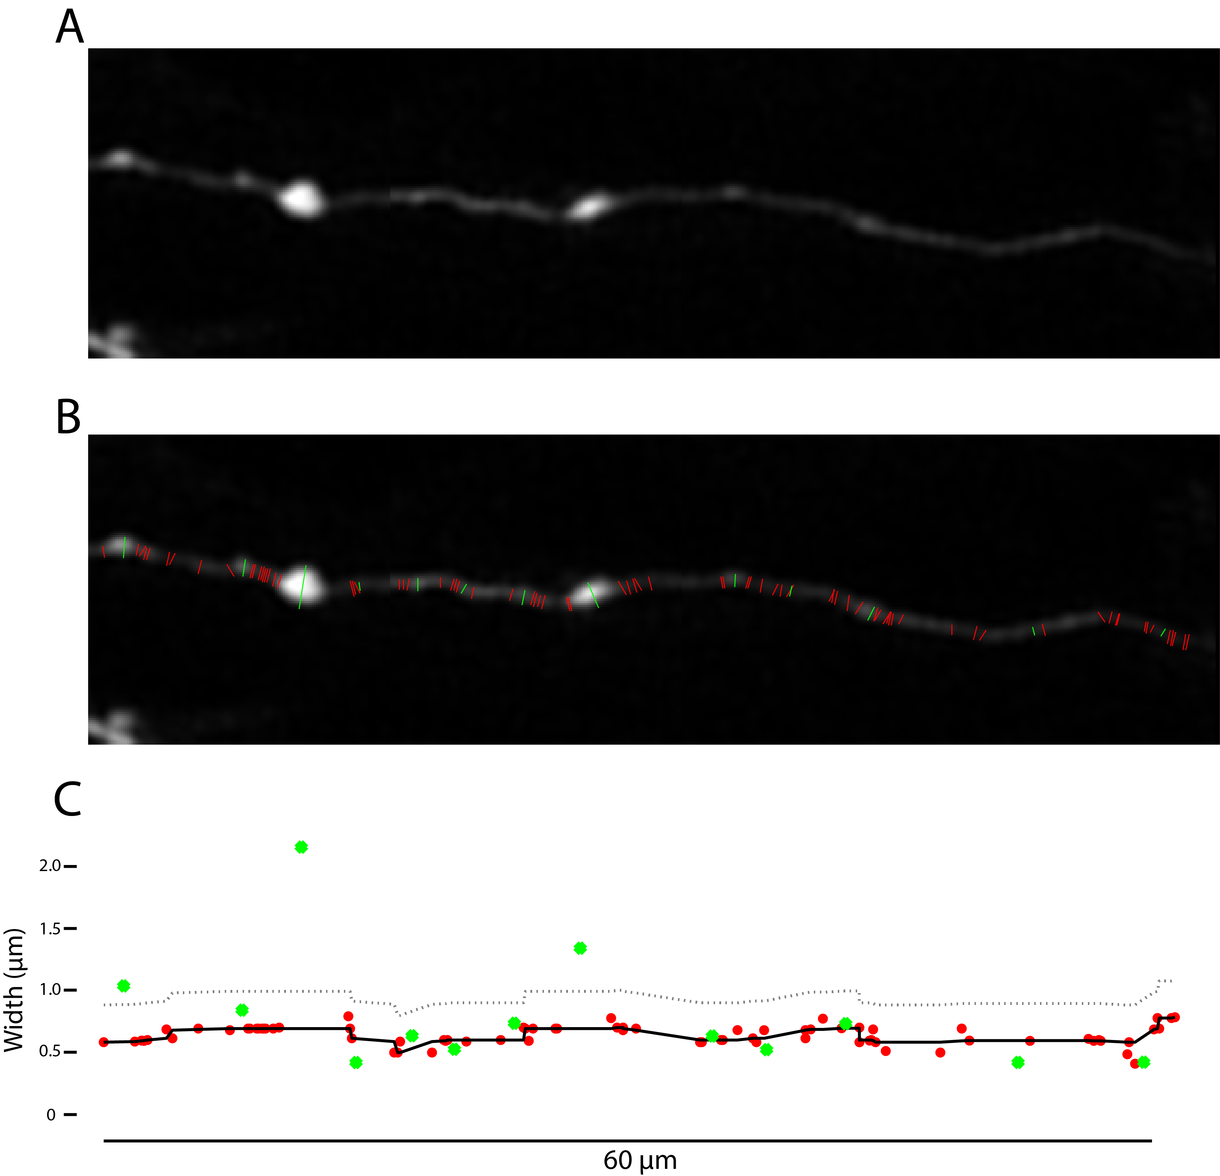
Figure 3: Semi-automated width measurements. A. Axon segment, spliced from best planes for each region used for analysis. B. Backbone width measurements in red, bouton candidate regions measured in green. Backbone candidates are automatically generated by searching for best cross angle near perpendicular, then generated by fitting with a gaussian and cutting off at 0.7 sd. All fits are presented to user, bad fits are manually rejected. User manually draws bouton width, matching locations between timepoints. Width is manually fit by user adjusting threshold as percent of local backbone intensity. C. backbone width measurements in red, bouton candidate width measurements in green. Bouton candidates must have a width >3 pixels larger (gray dotted line) than local median filtered backbone width(black line). Filter window 5 measurements.

